Slide 1

The art of CNN
Mahmoud Gamiel
Notes:
Everyone mint 150 hour videos uploaded on youtube

Slide 2
01
MOTIVATION
How is the process of vision in humans

Slide 3
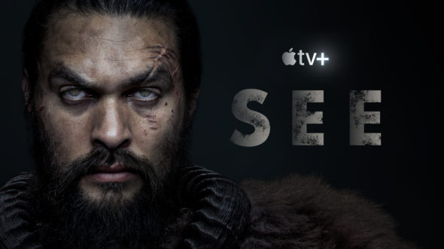
Notes:
540 million year no one can see

Slide 4
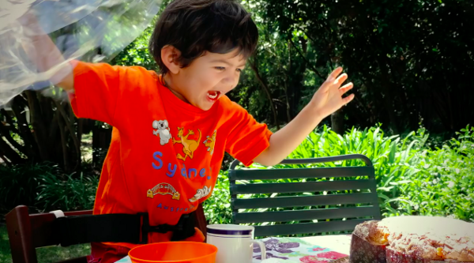

Slide 5
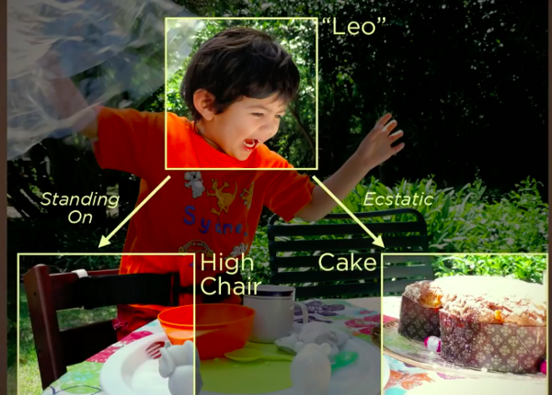

Slide 6


Slide 7
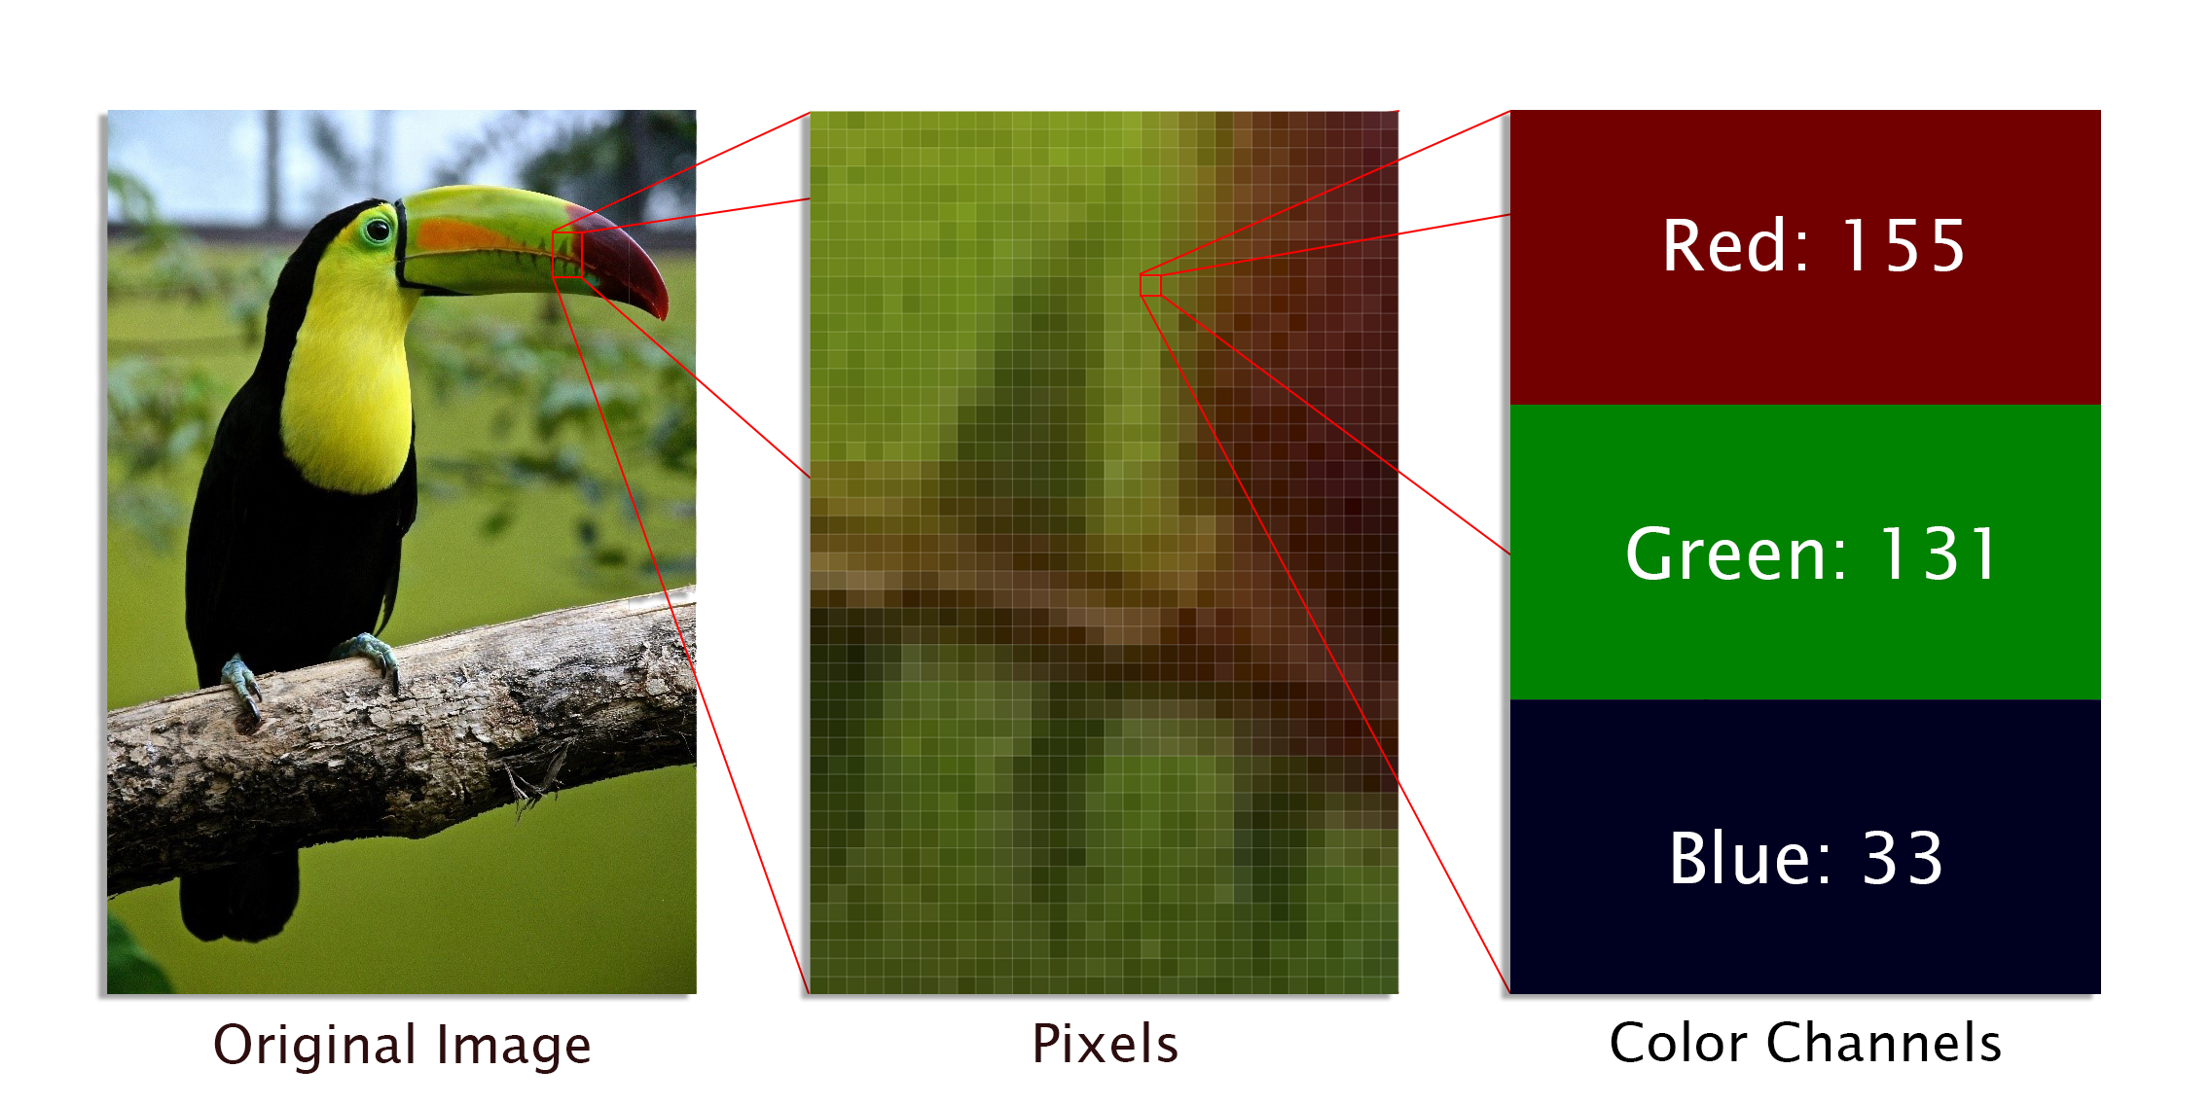

Slide 8
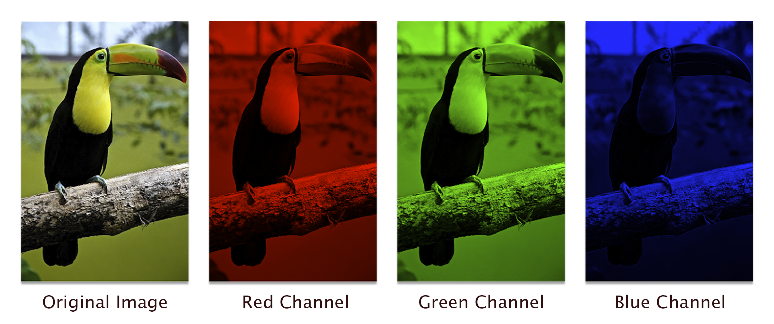

Slide 9
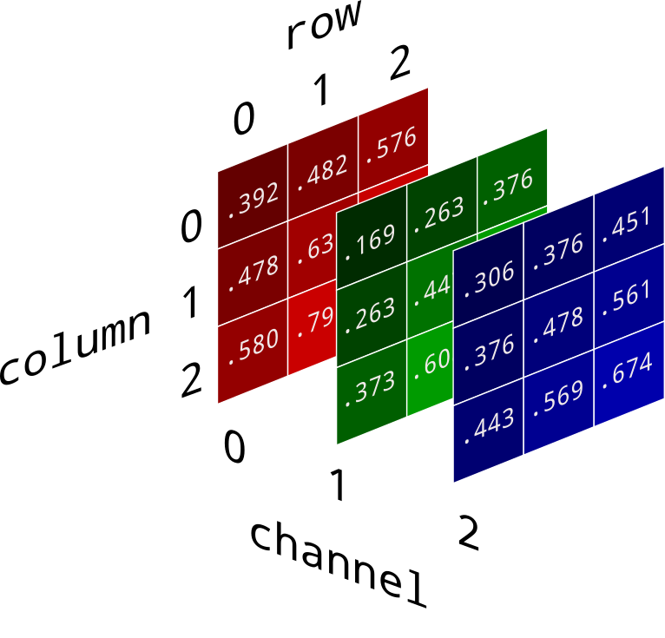
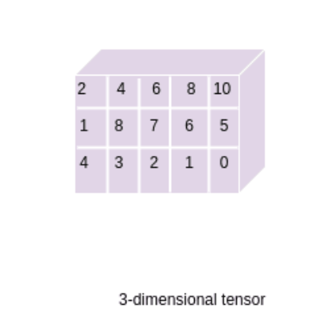

Slide 10
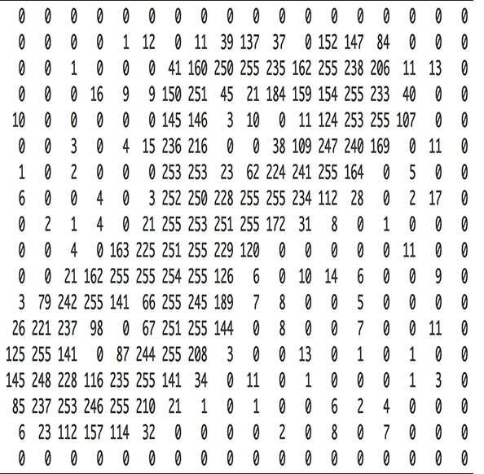


Slide 11
Why Convolution Neural Network ?
4x1
2x2
flatten
input

Slide 12

Let’s look inside CNN ,and discover it

Slide 13

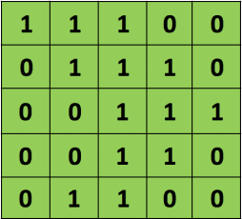
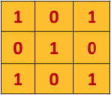
How is Convolution layer work ?
+
=

Slide 14
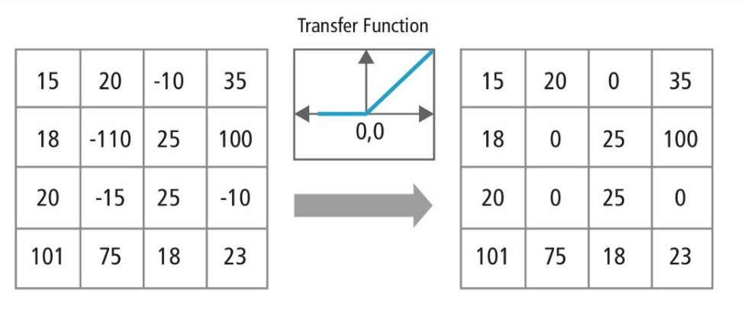

Slide 15

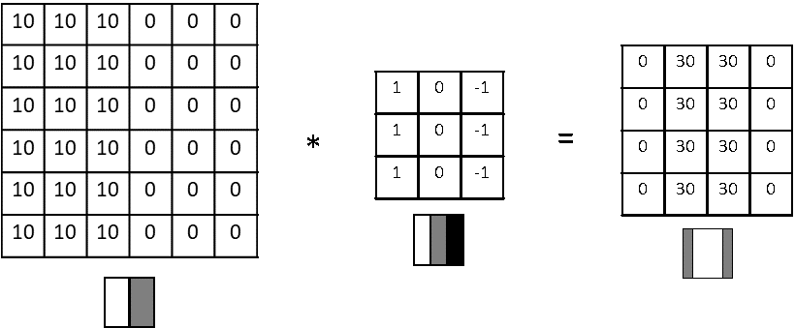
Why Convolution layer work ?

Slide 16
Notes on Convolution layer

Slide 17
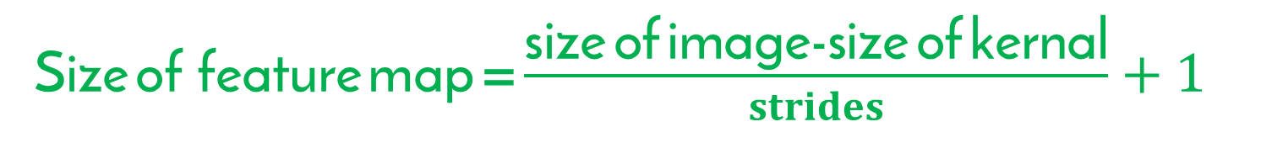
Strides : is the number of pixels shifts over the input matrix
Size of feature map = $\frac{\text{size} \text{of} \text{image}\text{−}\text{size} \text{of} \text{kernal}}{strides}+1$

Slide 18
Notes on Convolution layer

Slide 19
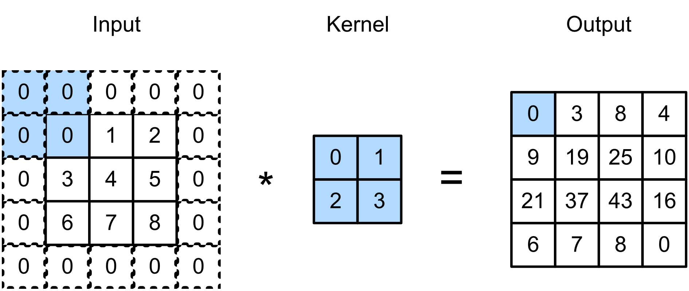

Slide 20

Padding : is simply a process of adding layers of zeros to our input images so as to avoid the problems mentioned above
Size of feature map = $\frac{\text{size} \text{of} \text{image}\text{+}\text{2}\text{p}\text{−}\text{size} \text{of} \text{kernal}}{strides}+1$

Slide 21
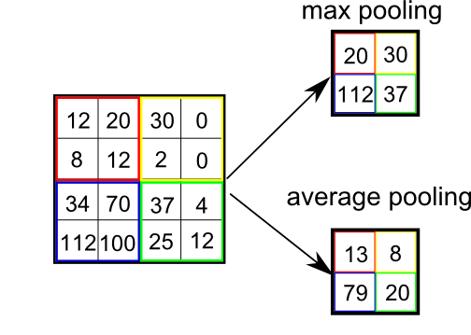
Pooling :

Slide 22
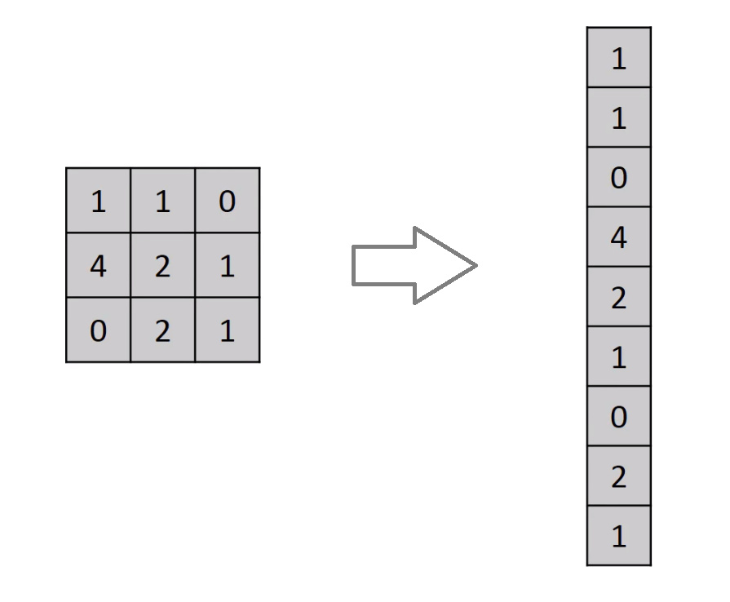
Flatten layer :

Slide 23
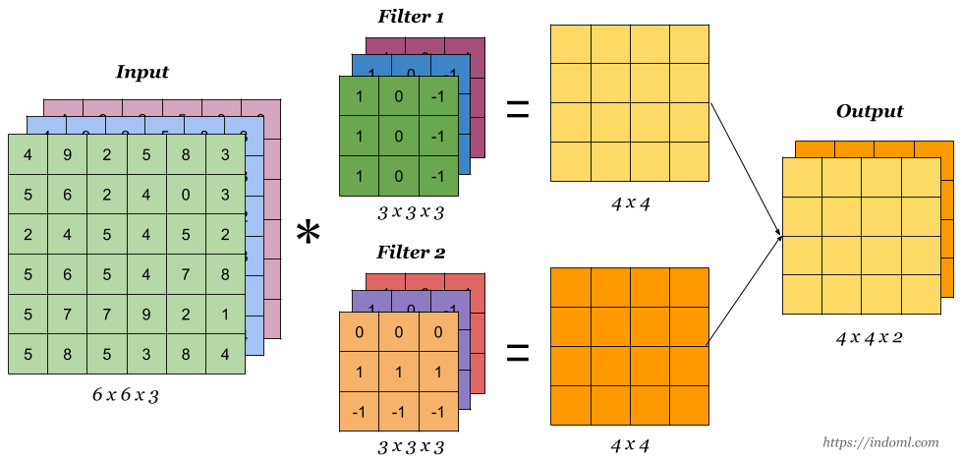

Slide 24


Slide 25
